Slide 1
PhonePe Transaction Insights Dashboard
Data Analysis using Python, MySQL, and Streamlit
Shashwath E P
AIML-S-WE-T-B32

Slide 2
Statement & Approach
Problem Statement
With the increasing reliance on digital payment systems like PhonePe, understanding the dynamics of transactions, user engagement, and insurance-related data is crucial for improving services and targeting users effectively. This project aims to analyze and visualize aggregated values of payment categories, create maps for total values at state and district levels, and identify top-performing states, districts, and pin codes.
Project Background
Digital payment platforms like PhonePe generate large volumes of transaction data.
Understanding transaction patterns, user engagement, and insurance adoption helps improve services and decision-making.
This project analyzes PhonePe Pulse data to:
Study payment category trends
Visualize transactions across states and districts
Identify top-performing regions in the digital payment ecosystem.

Slide 3
Project Overview
Transactions
Users
Insurance
Analyze volume and value of digital payments
Track trends across states and districts
Identify peak transaction periods
Study user adoption patterns over time
Compare growth across regions
Assess penetration at district level
Examine insurance product usage trends
Analyze regional adoption variations
Evaluate coverage across states
The PhonePe Pulse dataset powers this analysis, enabling a comprehensive view of India's digital payment ecosystem across all states and districts.

Slide 4
Project Objectives
Transaction Analysis
Regional Performance
User Growth Trends
Insurance Patterns
Evaluate total transaction volume across states and quarters
Assess transaction value to identify high-revenue regions
Identify top-performing states and districts by transaction count
Compare regional adoption to highlight growth opportunities
Study user registration patterns over time
Track quarterly and yearly adoption trajectories
Analyze insurance premium and policy count data
Identify states with highest insurance penetration
These four objectives collectively enable a comprehensive understanding of India's digital payment ecosystem through the PhonePe Pulse dataset.

Slide 5
Tools & Technologies
Python
Pandas & NumPy
MySQL
Core language for data extraction and processing
Handles JSON parsing and automation scripts
Data cleaning, transformation, and aggregation
Efficient handling of large datasets and arrays
Structured storage for processed transaction data
Enables efficient querying across states and districts
Streamlit
Plotly
GitHub
Powers the interactive web-based dashboard
Provides real-time filtering and user controls
Creates interactive charts and visual analytics
Supports dynamic, drill-down data exploration
Version control for collaborative development
Repository management and project documentation

Slide 6
Project Workflow
An automated pipeline transforming raw JSON data into visual insights
Step 1
Step 2
Step 3
Step 4
Step 5
JSON Dataset
Python Processing
Data Cleaning
MySQL Database
Streamlit Dashboard
Raw Data Source
Data Extraction
Transformation
Structured Storage
Interactive Visualization
PhonePe Pulse open-source dataset in nested JSON format
Parse and extract structured data using Python scripts
Handle missing values, standardize formats using Pandas and NumPy
Store cleaned data in relational tables for efficient querying
Render insights via Plotly charts with dynamic filters

Slide 7
Dashboard & Key Insights: Interactive features reveal consistent growth and regional adoption trends
Dashboard Features
State, year, and quarter filters for granular data exploration
Interactive charts powered by Plotly for dynamic visualization
Region-level comparison enabling side-by-side state and district analysis
User-friendly interface built with Streamlit for intuitive navigation
Key Insights
Certain states dominate transaction activity, led by Maharashtra, Karnataka, and Telangana
Consistent year-over-year growth in digital payment volume and value across India
District-level variations reveal uneven adoption patterns within the same state
Steady increase in user base indicating growing trust in digital payment platforms
The dashboard transforms complex PhonePe Pulse data into actionable insights, enabling intuitive exploration of India's digital payment landscape across multiple dimensions.

Slide 8
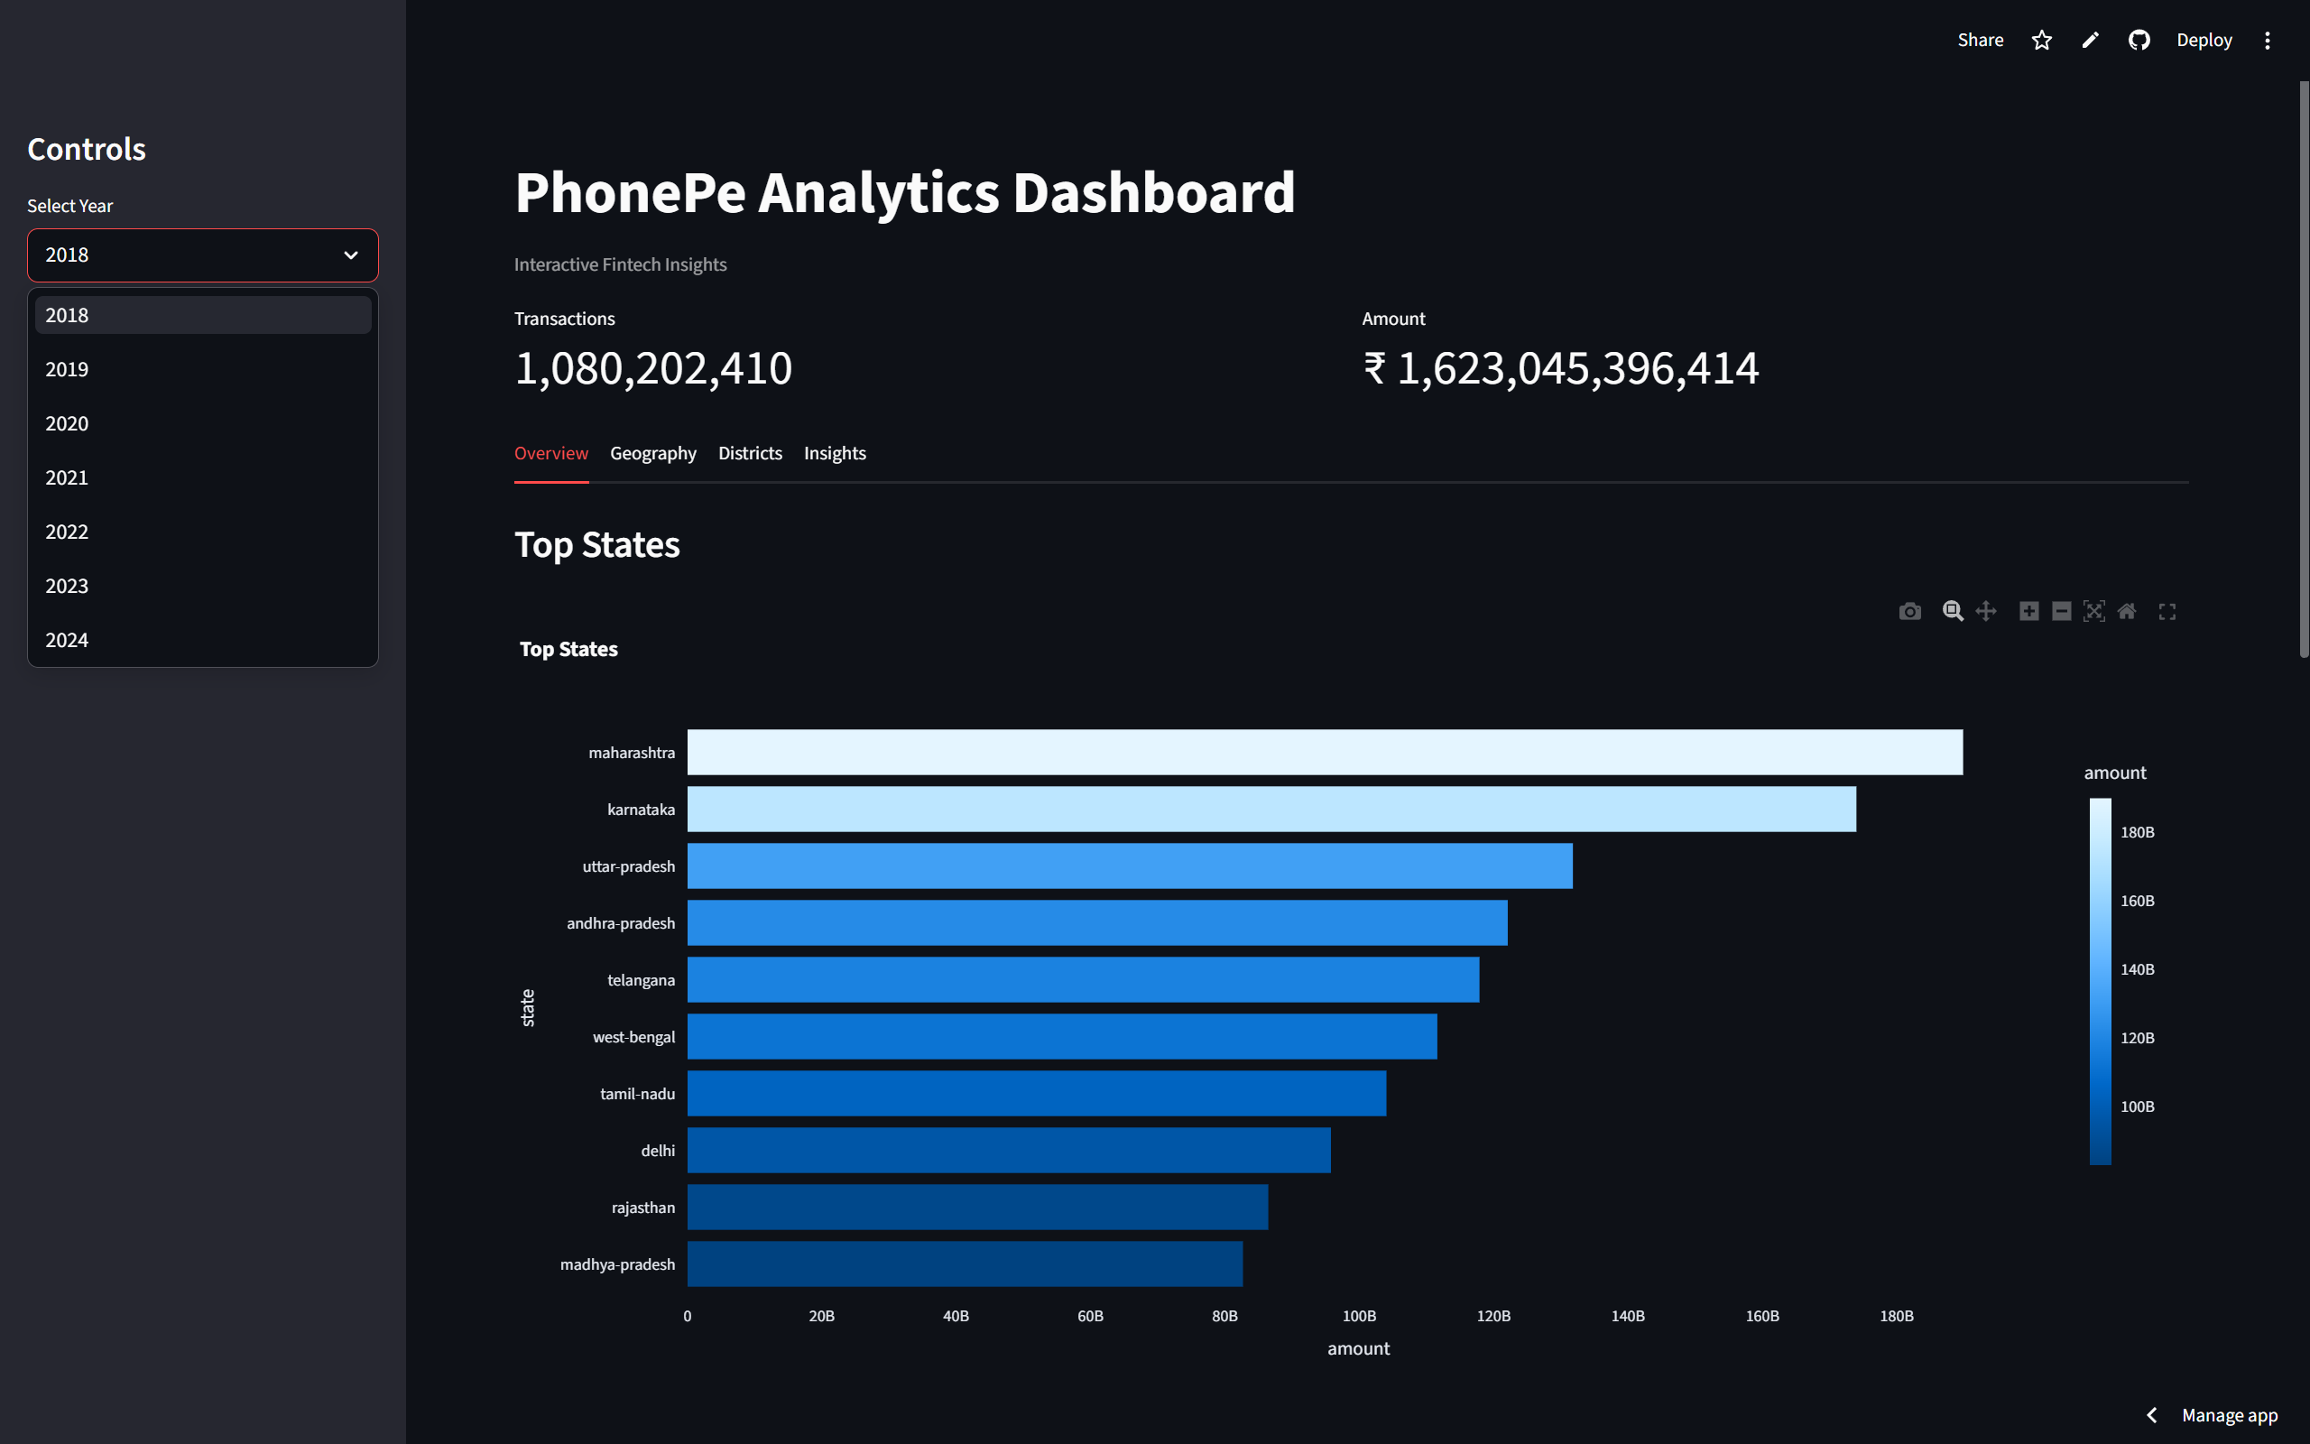
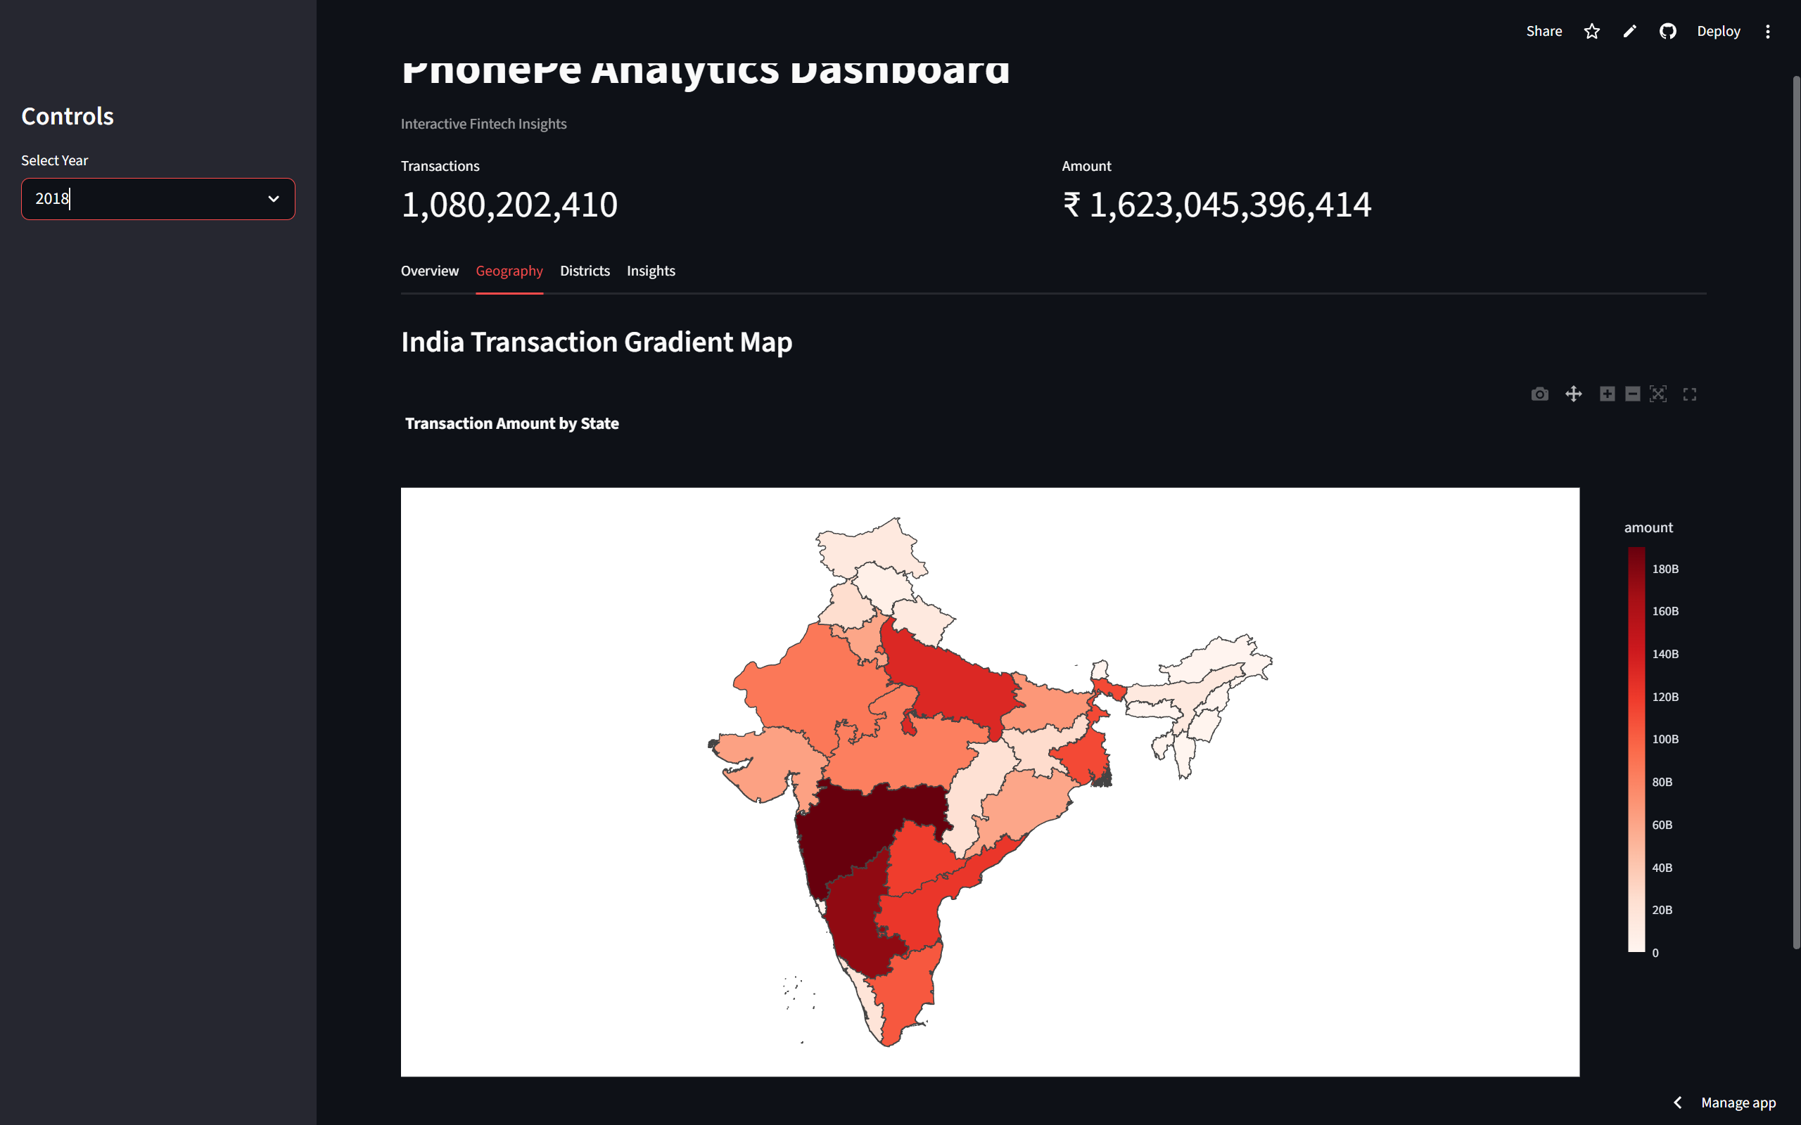
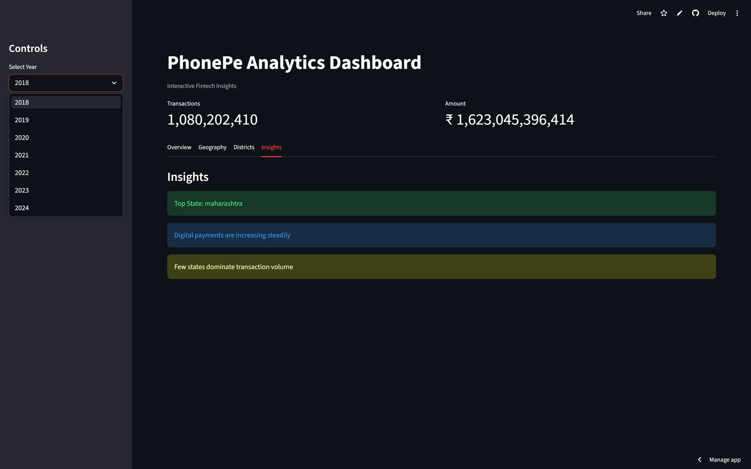
Dashboard
Overview tab
Geography tab
Insights tab

Slide 9
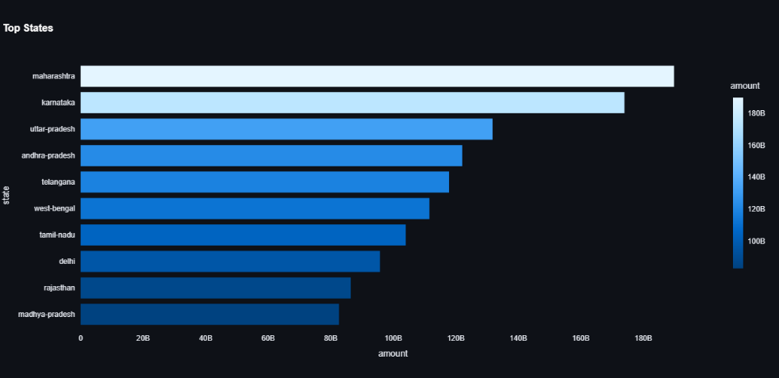
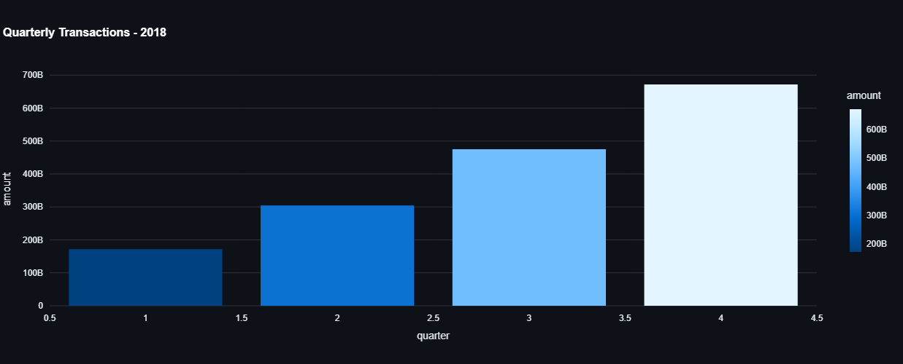
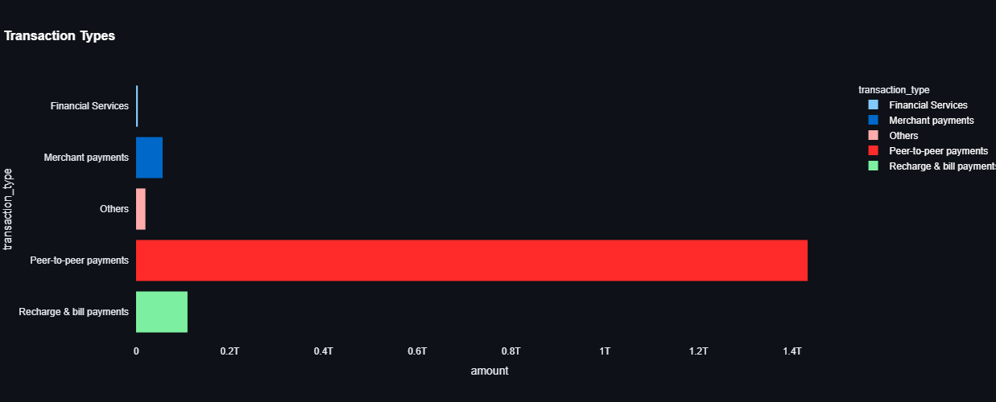
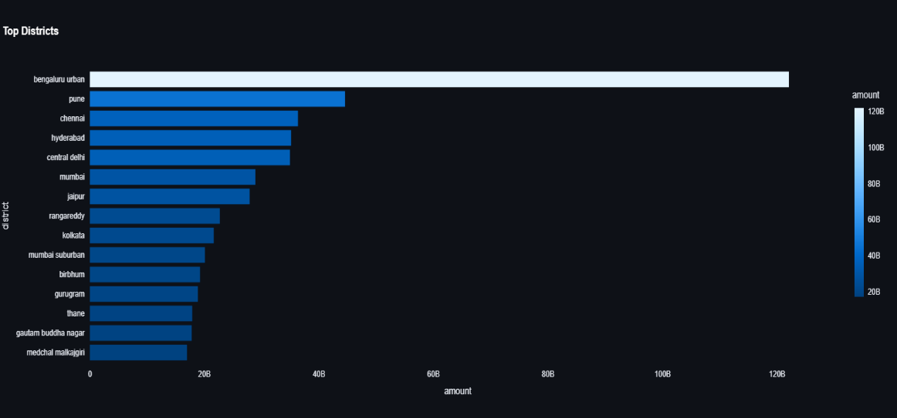
Analysis graphs based on 2018
Top States graph
Quarterly transaction graph
Mode of transaction graph
Top Cities graph

Slide 10
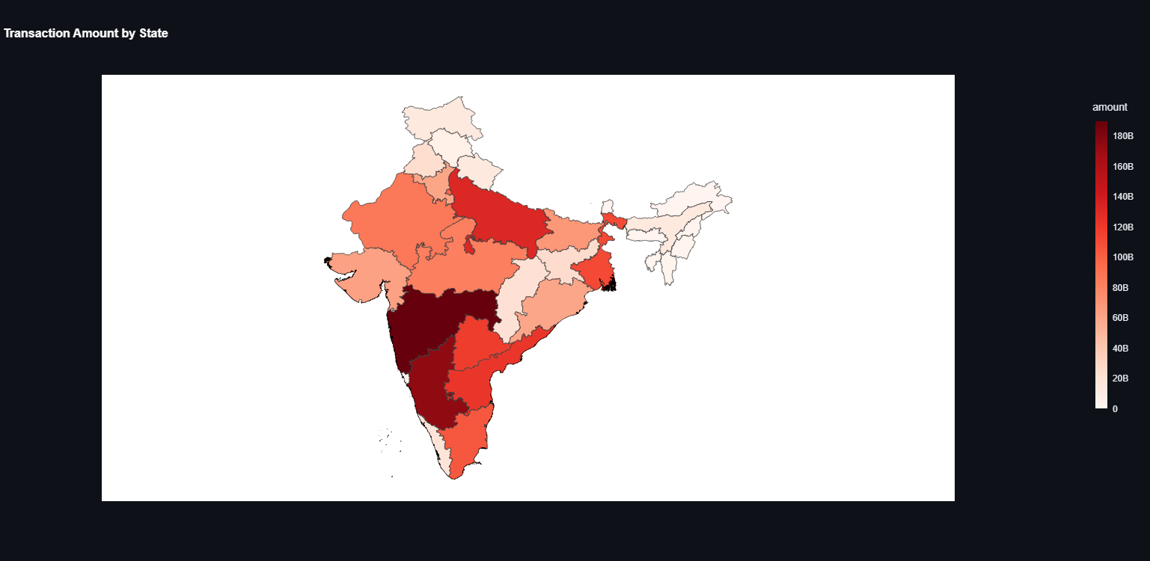
Heatmap based transaction on 2018

Slide 11
Challenges & Conclusion: Overcoming data complexity to deliver a scalable analytics solution
1
2
3
Challenges Faced
Conclusion
Future Scope
Parsing deeply nested JSON structures from PhonePe Pulse dataset
Managing data inconsistencies across states and time periods
Integrating MySQL database with Streamlit for seamless querying
Built a complete data analysis pipeline from raw data to dashboard
Transformed unstructured data into meaningful visual insights
Delivered an interactive Streamlit dashboard for exploring digital payment trends
Real-time data integration for live transaction monitoring
Machine learning predictions to forecast payment trends
Enhanced dashboard with advanced filtering and drill-down features
This project demonstrates a scalable approach to analyzing India's digital payment ecosystem, converting complex raw data into actionable insights through an end-to-end analytics pipeline.

Slide 12
Links
Dashboard:
https://phonepe-transaction-insights-wnyxutj3rxp9wxr9vvqee2.streamlit.app/
GitHub:
https://github.com/Shashwath-EP/phonepe-transaction-insights

